Slide 1
Beyond the Basic SELECT
Deborah Melkin
DBA Fundamentals VG
July 28, 2020

Slide 2



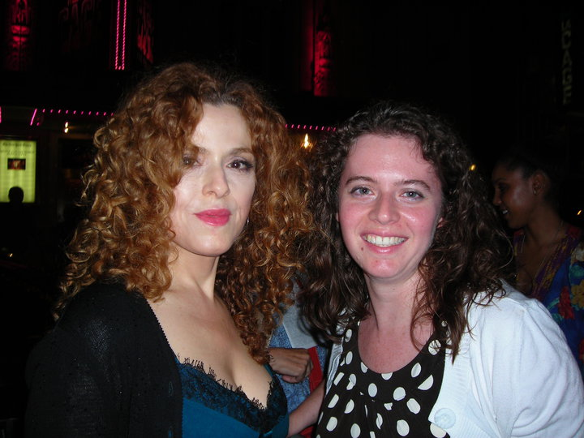
Beyond the Basics: Me
20 years as a DBA
Mainly work with SQL Server
Mainly work with OLTP but have worked with some data marts.
NESQL Board Member
SQL Saturday\User Group Speaker
IDERA ACE Class of 2020
Speaker Idol Winner 2019
Random facts:
I’m the alto section leader in my choir.
I go to bluegrass jams regularly.
I’ve been learning guitar and now mandolin.
I am a bit of a musical theater geek.

Slide 3

Who did NOT execute a SELECT statement Today?

Slide 4
SELECT sod.SalesOrderID
FROM Sales.SalesOrderDetail as sod

Slide 5
;
WITH employee_cte AS
(
SELECT e.BusinessEntityID, e.JobTitle,
e.OrganizationNode.ToString() as OrgChart, ManagerBusinessEntityID, ISNULL(e.OrganizationNode.ToString(), '0') as ManagerOrgChart
FROM HumanResources.Employee e
WHERE e.ManagerBusinessEntityID IS NULL
UNION ALL
SELECT hre.BusinessEntityID, hre.JobTitle,
hre.OrganizationNode.ToString() as OrgChart, hre.ManagerBusinessEntityID, ISNULL(cte.ManagerOrgChart, '') + ' | ' + REPLACE(hre.OrganizationNode.ToString(), '/', '')
FROM HumanResources.Employee hre
JOIN employee_cte cte ON hre.ManagerBusinessEntityID = cte.BusinessEntityID
)
SELECT
cte.BusinessEntityID, p.FirstName, p.LastName, cte.JobTitle, sp.TerritoryName as SalesTerritory, sp.TerritoryGroup,
mp.FirstName as ManagerFirstName, mp.LastName as ManagerLastName, cte.ManagerOrgChart,
orders.CustomerID, orders.AccountNumber, orders.StoreID, orders.TerritoryID, orders.TotalSalesOrdersPerSalesPerson,
orders.TotalDue, orders.TotalDueForCustomer, orders.AvgSalesOrderAmt, orders.TotalNumberOfShipments, orders.TotalSalesOrderQuanity,
orders.WeightedAvgPricePerQty, orders.AvgNumberOfProducts, orders.MaxNumberOfProducts, orders.MinNumberOfProducts
FROM employee_cte cte
JOIN Person.Person p ON cte.BusinessEntityID = p.BusinessEntityID
JOIN Sales.vSalesPerson sp ON cte.BusinessEntityID = sp.BusinessEntityID
JOIN (
SELECT
c.CustomerID, c.AccountNumber, c.StoreID, c.TerritoryID,
soh.SalesPersonID,
COUNT(soh.SalesOrderID) OVER(PARTITION BY c.CustomerID, soh.SalesPersonID) as TotalSalesOrdersPerSalesPerson,
SUM(soh.TotalDue) OVER(PARTITION BY c.CustomerID, soh.SalesPersonID) as TotalDue,
SUM(soh.TotalDue) OVER(PARTITION BY c.CustomerID) as TotalDueForCustomer,
SUM(soh.TotalDue) OVER(PARTITION BY c.CustomerID, soh.SalesPersonID)
/Count(soh.SalesOrderID) OVER(PARTITION BY c.CustomerID, soh.SalesPersonID) as AvgSalesOrderAmt,
SUM(details.NumberOfShipments) OVER(PARTITION BY c.CustomerID, soh.SalesPersonID) as TotalNumberOfShipments,
SUM(details.TotalQuantity) OVER(PARTITION BY c.CustomerID, soh.SalesPersonID) as TotalSalesOrderQuanity,
SUM(details.WeightedAvgPrice) OVER(PARTITION BY c.CustomerID, soh.SalesPersonID)
/COUNT(soh.SalesOrderID) OVER(PARTITION BY c.CustomerID, soh.SalesPersonID) as WeightedAvgPricePerQty,
AVG(details.AvgOrderQty) OVER(PARTITION BY c.CustomerID) as AvgNumberOfProducts,
MAX(details.MaxOrderQty) OVER(PARTITION BY c.CustomerID) as MaxNumberOfProducts,
MIN(details.MinOrderQty) OVER(PARTITION BY c.CustomerID) as MinNumberOfProducts
FROM Sales.Customer c
JOIN Sales.SalesOrderHeader soh ON soh.CustomerID = c.CustomerID
JOIN (
SELECT sod.SalesOrderID,
COUNT(distinct CarrierTrackingNumber) as NumberofShipments,
COUNT(distinct ProductID) as NumberofProducts,
SUM(sod.OrderQty) as TotalQuantity,
AVG(sod.OrderQty) as AvgQuantityPerProduct,
SUM(sod.OrderQty * sod.UnitPrice) as SubTotal,
SUM(sod.UnitPriceDiscount * sod.OrderQty) as TotalUnitDiscount,
SUM([dbo].[ufnGetProductListPrice](sod.ProductID, sod.ModifiedDate) * sod.OrderQty)
as TotalUsingListPrice,
SUM(UnitPrice * sod.OrderQty)/SUM(sod.OrderQty) as WeightedAvgPrice,
AVG(UnitPrice) as AvgUnitPrice,
MIN(UnitPrice) as MinUnitPrice,
MAX(UnitPrice) as MaxUnitPrice,
AVG(OrderQty) as AvgOrderQty,
MIN(OrderQty) as MinOrderQty,
MAX(OrderQty) as MaxOrderQty
FROM Sales.SalesOrderDetail sod
GROUP BY sod.SalesOrderID
) details ON soh.SalesOrderID = details.SalesOrderID
) orders ON orders.SalesPersonID = sp.BusinessEntityID
LEFT JOIN Person.Person mp ON cte.ManagerBusinessEntityID = mp.BusinessEntityID
ORDER BY cte.ManagerOrgChart

Slide 6
Agenda
SELECT FROM “fancy rowsets”
SELECT “fancy column list” FROM rowsets

Slide 7
Logical Order of Operation
SELECT
[distinct]
[top (@number)]
<column list>
FROM <table> as A
JOIN <table> as B
ON A.id = B.ID
LEFT OUTER JOIN <table> as C
ON A.ID = C.ID
WHERE <condition>
GROUP BY <column list>
HAVING <condition>
ORDER BY <column list>
FROM
ON
OUTER
WHERE
GROUP BY
HAVING
SELECT
DISTINCT
ORDER BY
TOP
Notes:
Itzik Ben-Gan had a series of articles for SQL Server Mag on this topic. Start here:
http://www.itprotoday.com/sql-server/logical-query-processing-what-it-and-what-it-means-you
(Look at the list of questions at the end he assigns as homework.) You can find the other articles in that series on his author page.

Slide 8

Time to get “fancy”…

Slide 9
Derived Tables
SELECT <column list>
FROM (
SELECT <column list>
FROM <table(s)>
) as DerivedTable

Slide 10
CTE (Common Table Expressions)
;
WITH cte AS (
SELECT <column list>
FROM <table(s)>
)
SELECT <column list>
FROM cte

Slide 11
Views
SELECT <column list>
FROM vw_View

Slide 12
User Defined Functions
SELECT <column list>
FROM udf_userdefinedfunction ()
SELECT <column list>,
udf_userdefinedfunction ()
FROM <rowset>

Slide 13
Windowed Functions
SELECT ROW_NUMBER() OVER(),
SUM() OVER(),
COUNT() OVER(),
PERCENTILE_RANK() OVER()
FROM <rowset>

Slide 14
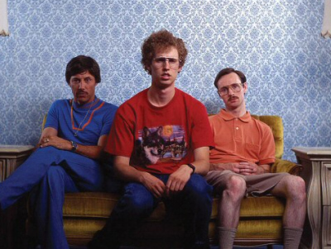
Let’s take a look…
This Photo by Unknown Author is licensed under CC BY-NC-ND

Slide 15
Derived Tables: Pros & Cons
Pros:
Cons:
Commonly used
Easy to use
Not “reusable” from one query to another
Query plan may not directly reflect the derived table

Slide 16
CTE: Pros & Cons
Pros:
Cons:
Great for hierarchical data
Could be used to avoid temporary tables
Not “reusable” from one query to another
Can create performance problems in certain scenarios
Not necessarily faster

Slide 17
Views: Pros & Cons
Pros:
Cons:
Reusable code
Great for prepackaging reports for end users
Indexed Views
May cause execution plans to involve tables that aren’t needed by the final query
Hard to troubleshoot nested views
Indexed views may not use the indexes or have the underlying data change too often
May not improve performance
Notes:
https://www.scarydba.com/2018/05/14/a-view-will-not-make-your-query-faster/
http://www.sqlhammer.com/sql-server-schemabinding/
https://www.red-gate.com/simple-talk/sql/learn-sql-server/sql-server-indexed-views-the-basics/
https://docs.microsoft.com/en-us/previous-versions/sql/sql-server-2008/dd171921(v=sql.100)

Slide 18
User Defined Functions: Pros & Cons
Pros:
Cons:
Reusable code
Can be used to implement Security Policy functionality
SQL Server is working to improve performance: MTVFs with SQL 2017, scalar functions with SQL 2019
Depends on your SQL Server version
Actual Execution Plans may not show underlying tables depending on the type of UDF
Inaccurate query plans caused by SQL Server cardinality estimates
Notes:
Great resource on the different types of functions:
https://www.red-gate.com/simple-talk/sql/t-sql-programming/sql-server-user-defined-functions/
Interleaved Executions: https://blogs.msdn.microsoft.com/sqlserverstorageengine/2017/04/19/introducing-interleaved-execution-for-multi-statement-table-valued-functions/

Slide 19
Windowed Functions: Pros & Cons
Pros:
Cons:
Flexibility for levels of aggregation on row levels
Performance
Cannot use in WHERE clause
Some performance issues may occur
Notes:
https://sqlperformance.com/2013/03/t-sql-queries/the-problem-with-window-functions-and-views

Slide 20
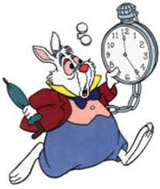
Additional “Fancy Rabbit Holes”
SELECT XML(), JSON_VALUE()
FROM OPENROWSET()\OPENQUERY()\OPENXML()
FROM linkedserver.schema.table
CROSS APPLY\OUTER APPLY
UNION (ALL)\INTERSECT\EXCEPT
etc...
This Photo by Unknown Author is licensed under CC BY-NC-ND

Slide 21
Final Thoughts
No Silver Bullet when trying to troubleshoot
Performance, Performance, Performance
Test, Test, Test
Your Mileage May Vary
Keep It Simple
Even if your code doesn’t change, the way SQL Server processes it may.

Slide 22
Additional Resources
Logical Query Processing:
http://www.itprotoday.com/sql-server/logical-query-processing-what-it-and-what-it-means-you
Schemabinding with Views:
http://www.sqlhammer.com/sql-server-schemabinding/
Views and Performance:
https://www.scarydba.com/2018/05/14/a-view-will-not-make-your-query-faster/
User Defined Functions:
https://www.red-gate.com/simple-talk/sql/t-sql-programming/sql-server-user-defined-functions/

Slide 23
Additional Resources (cont’d)
Interleaved Execution with UDFs:
https://blogs.msdn.microsoft.com/sqlserverstorageengine/2017/04/19/introducing-interleaved-execution-for-multi-statement-table-valued-functions/
https://blogs.msdn.microsoft.com/sqlserverstorageengine/2018/11/07/introducing-scalar-udf-inlining/
Window Functions:
https://sqlperformance.com/2013/03/t-sql-queries/the-problem-with-window-functions-and-views
https://sqlperformance.com/2019/08/sql-performance/t-sql-bugs-pitfalls-and-best-practices-window-function

Slide 24



Beyond the Session: Additional Questions? Let me know!
Email: dgmelkin@gmail.com
Twitter: @dgmelkin
Blog: DebtheDBA.wordpress.com
Thanks for coming!

